Slide 1


myHealth ADVANCED SOFTWARE ENGINEERING PROJECT WORK

Slide 2

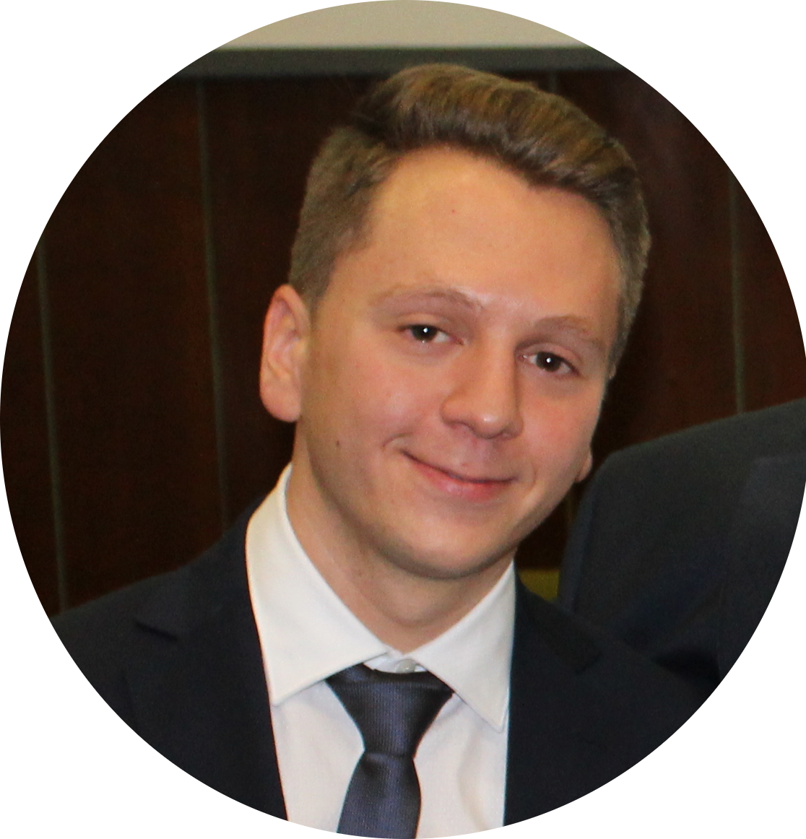
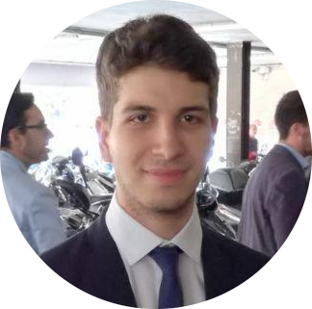
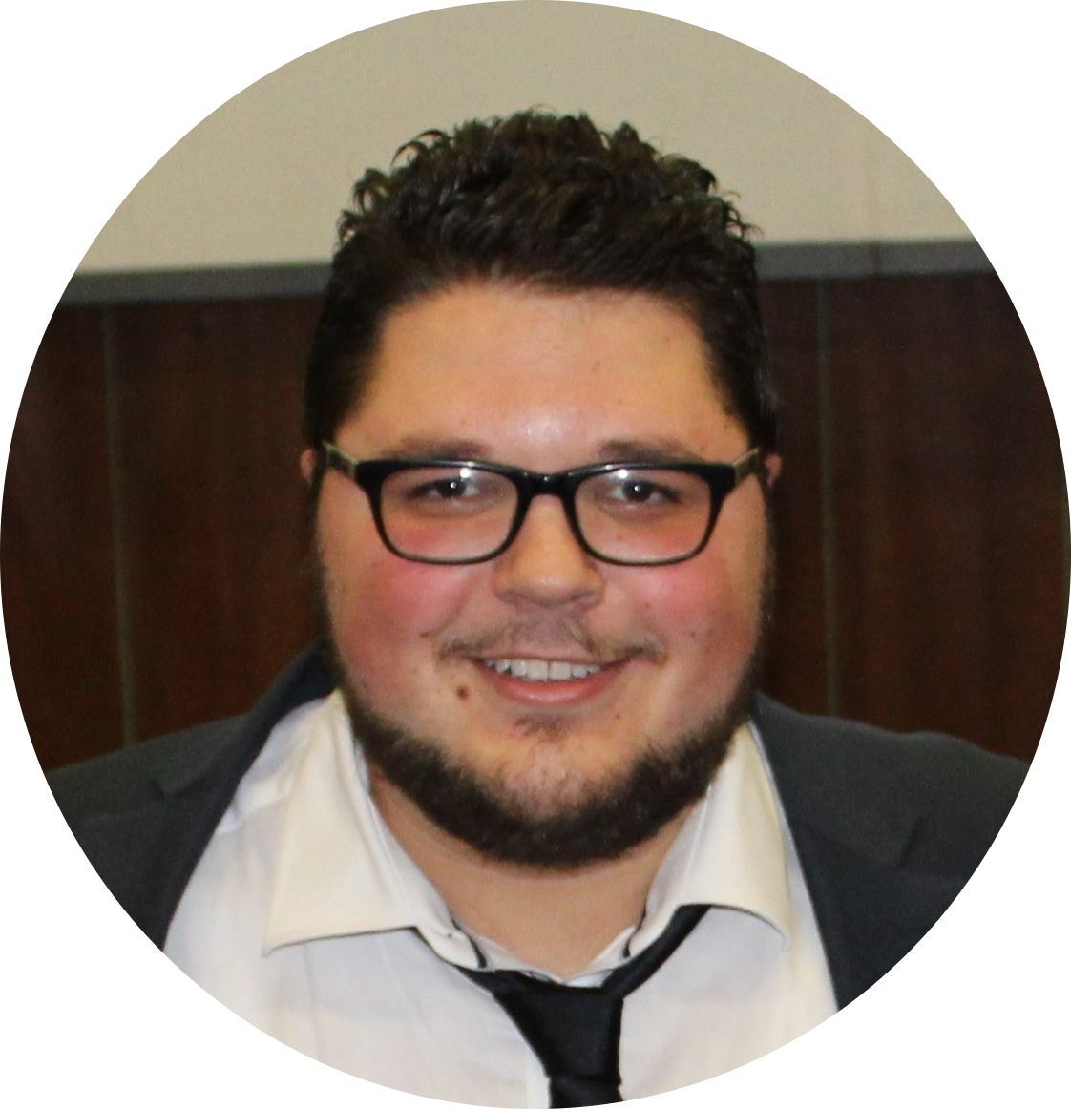
About us
LUIGI BISCEGLIA
Designed and implemented server, database and app GUI
DANIELE MALITESTA
Designed and implemented
MQTT communications, Google Play Scraper and dummy apps
BERARDINO PRENCIPE
Designed and implemented User model for self-adaptation
PROF. ING. MARINA MONGIELLO
ING. FRANCESCO NOCERA

Slide 3
SUMMARY
Introduction and motivation
myHealth main features
Architetcure
Test cases
Counclusions and future works
myHealth addresses users who care about health and represents a tool to monitor and manage differents apps and devices that collect user’s data.

Slide 4
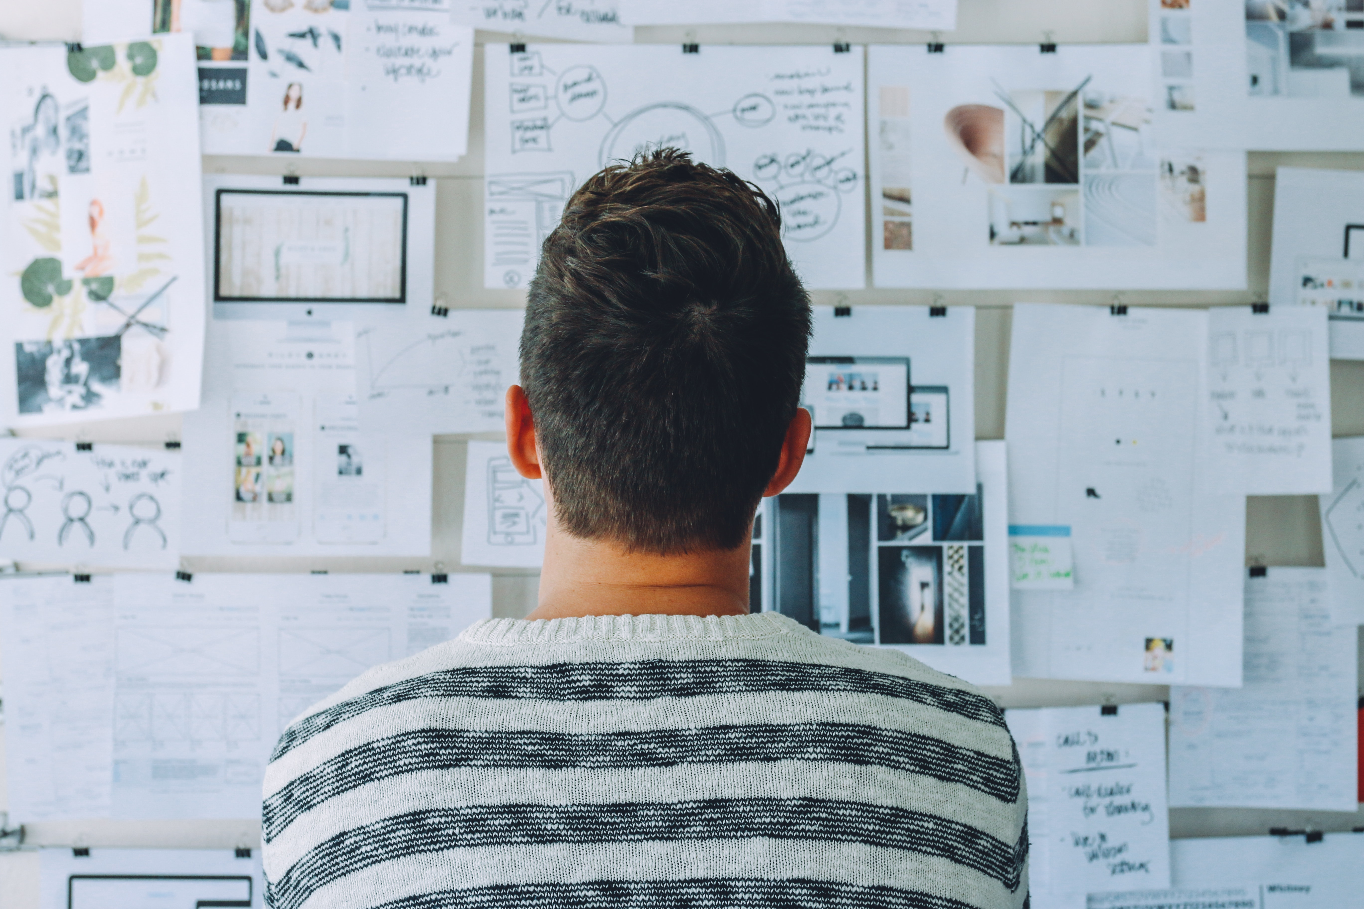
1.
INTRODUCTION AND MOTIVATION
Let’s start with motivations about this project work

Slide 5
Introduction and motivation
MANY APP NO COORDINATION
There are a lot of apps in eHealth domain to collect data, however none of them is able to coordinate all these parameters. Existing ones are closed to external word.
HIGH INTEREST IN HEALTH DOMAIN
Looking at the number of downloaded apps in health domain it is clear there are a lot of users interested in this domain.

Slide 6
Some number about eHealth
200,000 apps
Existing eHealth app on PlayStore in 2018
78,000 apps
New app in 2017 on PlayStore
A growing trend

Slide 7
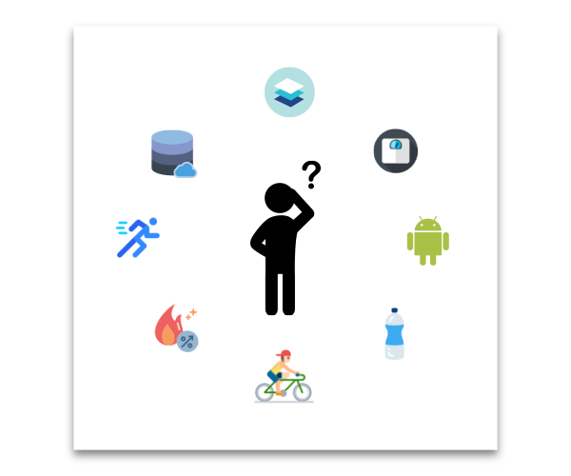
A possible scenario

Slide 8
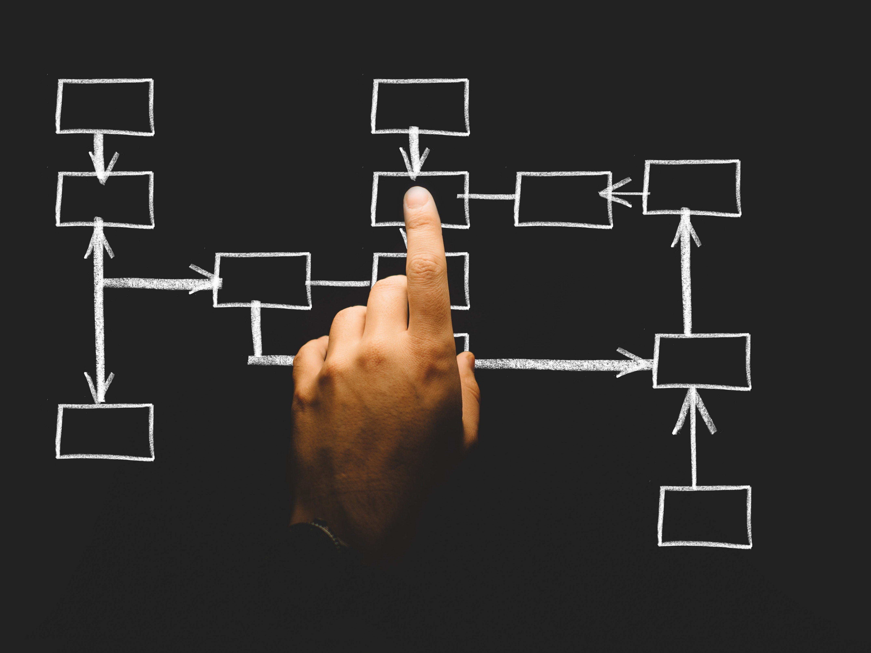
2.
MYHEALTH MAIN FEATURES
Let’s see main features of the application

Slide 9
In a nutshell
Self Adaptive
Easy to use
MAIN FEATURES
Open standard
Health Care

Slide 10
Exploring funtionalities
Easy to use
Material design graphical interface, hidden interactions with server and database.
Health care
Users can improve their lifestyle without fixing any goal.
Self Adaptive
User model adapts to user day by day, giving useful suggestions and tips.
Open Standard
Interfaces to let external apps send health data.

Slide 11
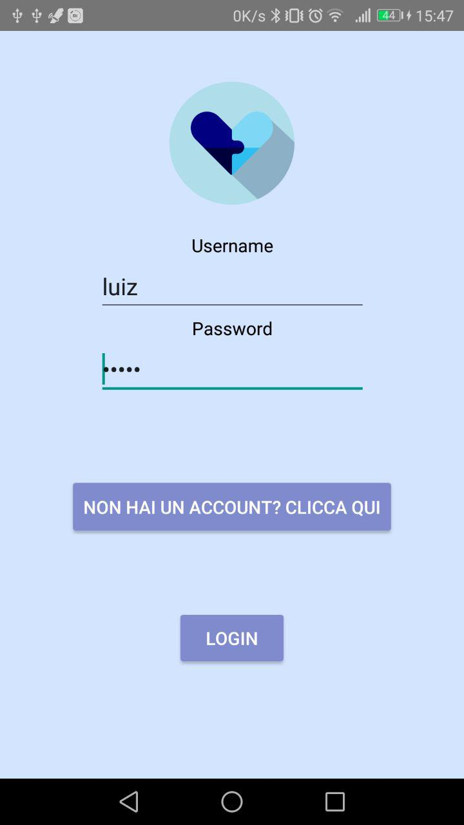
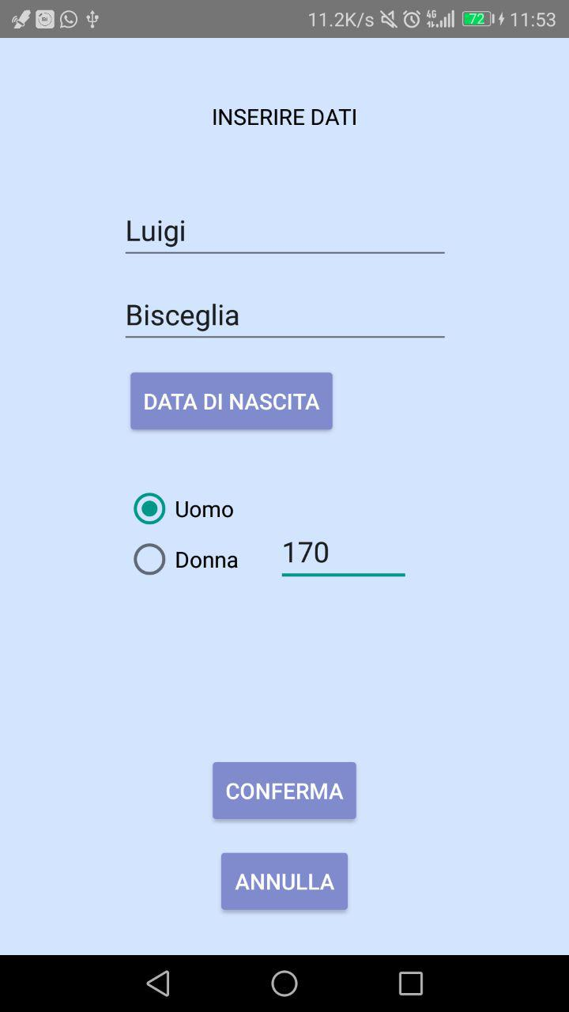
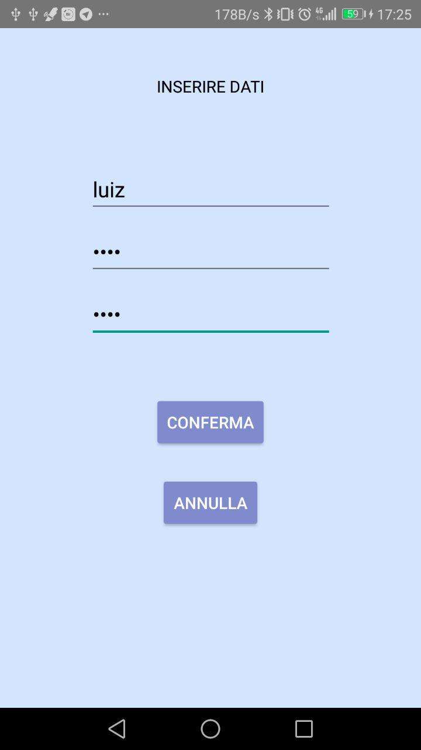
App GUI

Slide 12
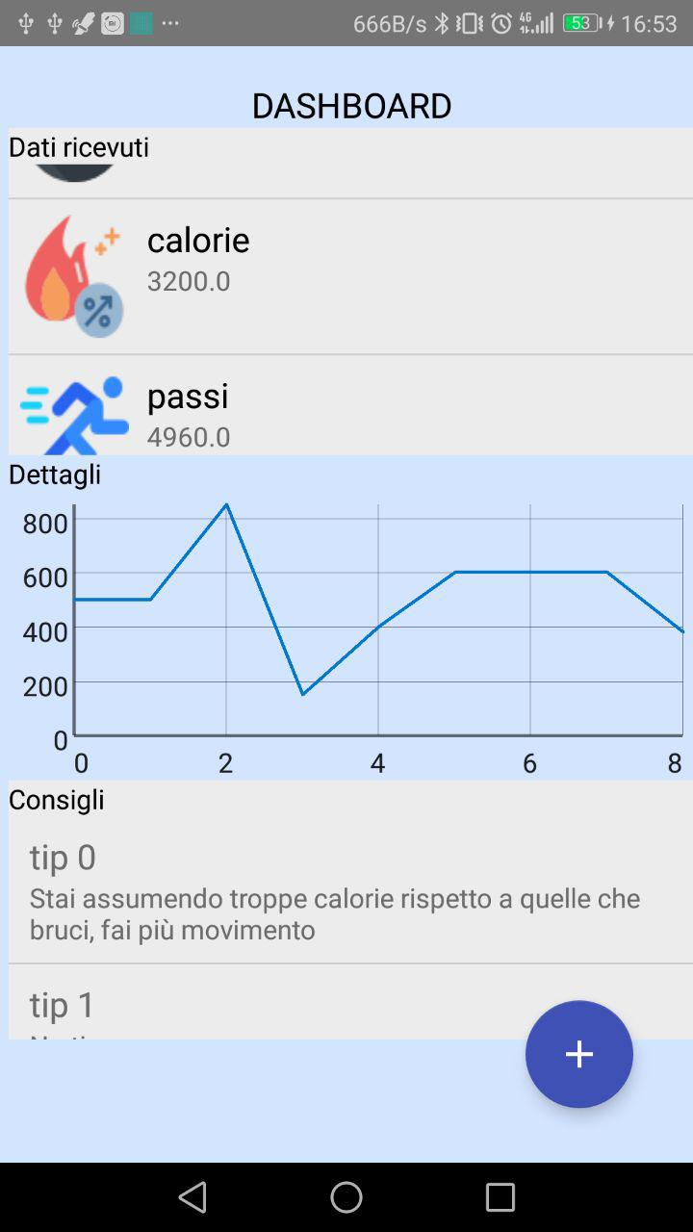
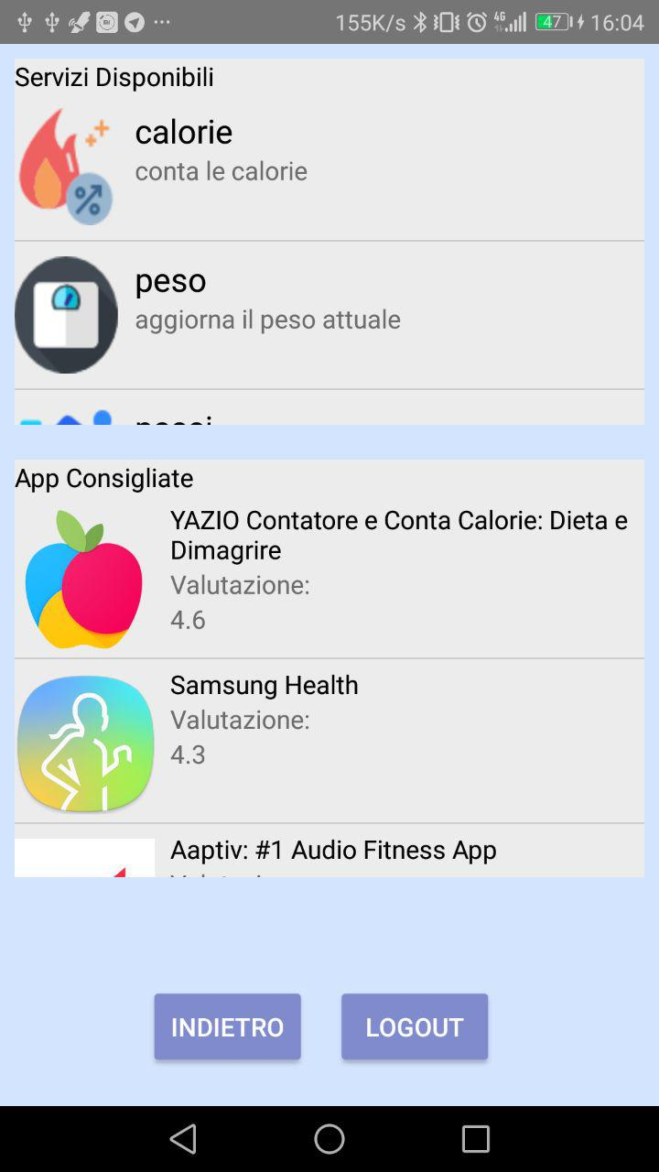
App GUI

Slide 13
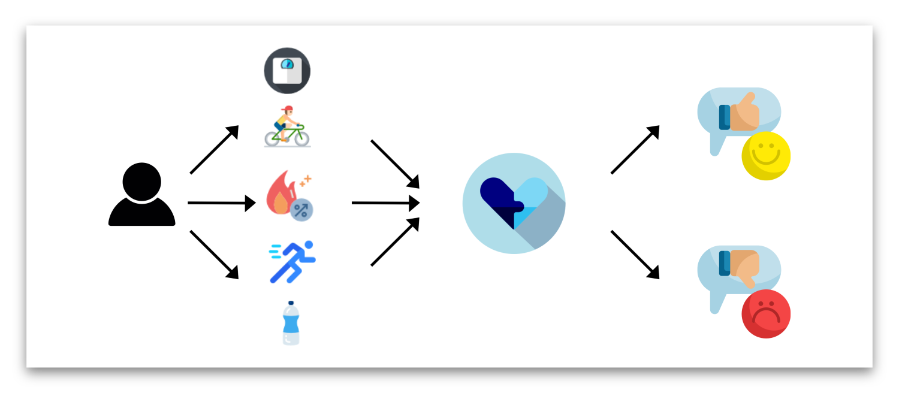
Our process is easy

Slide 14
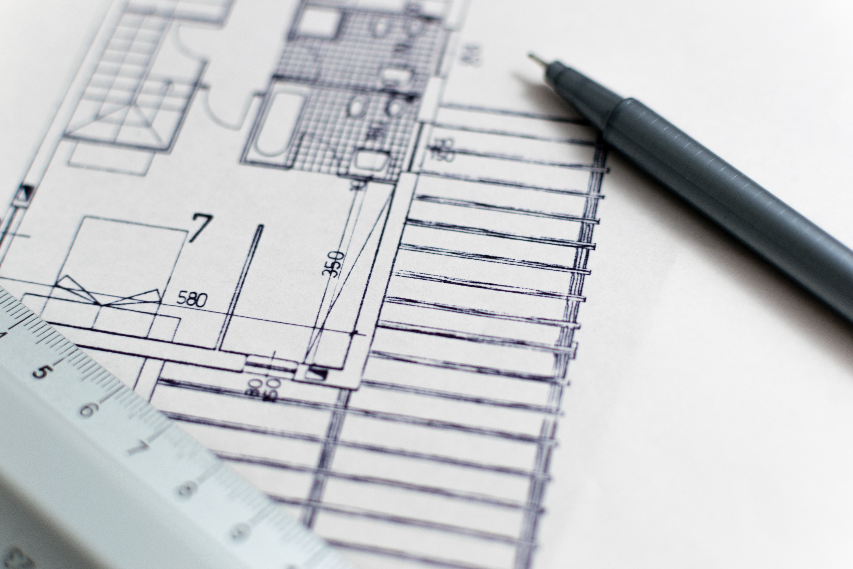
3. ARCHITECURE
Focus on components

Slide 15
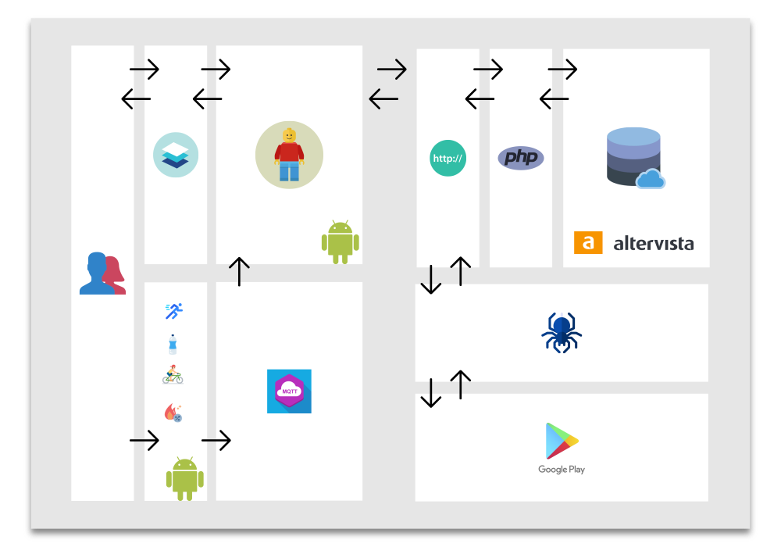

Slide 16
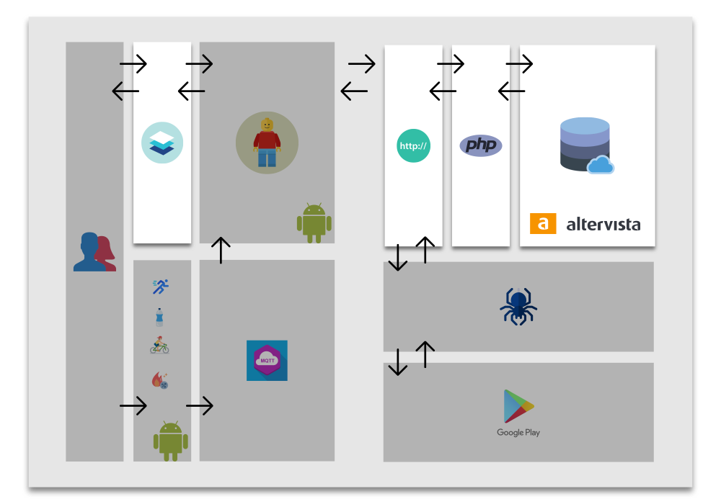

Slide 17
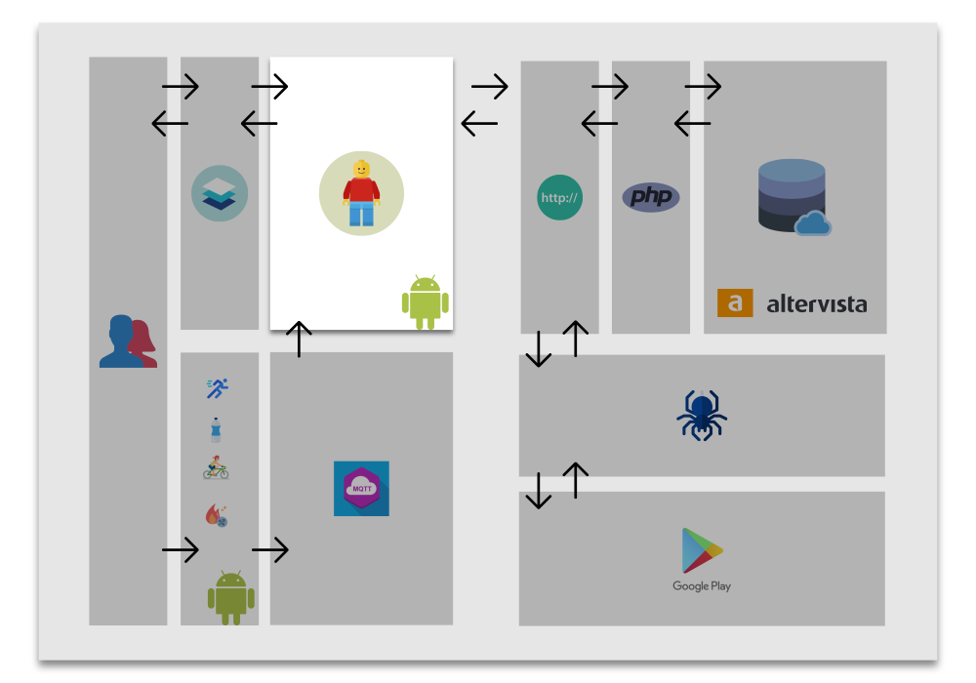

Slide 18
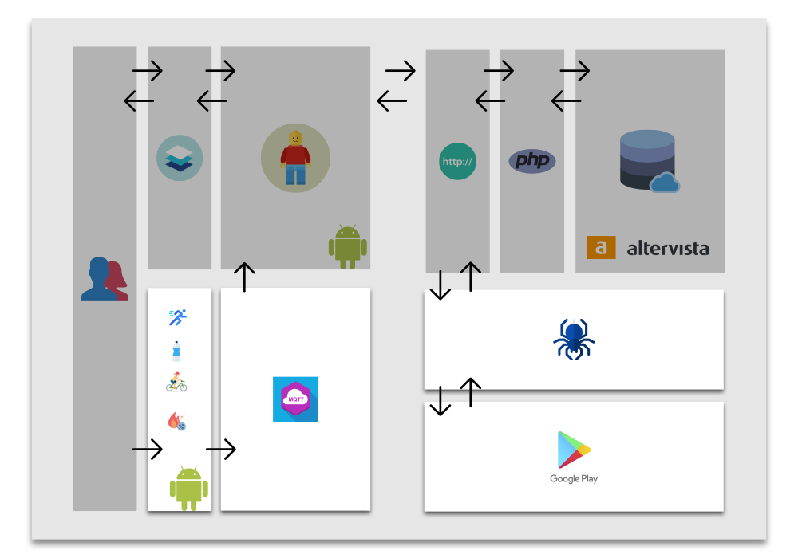

Slide 19
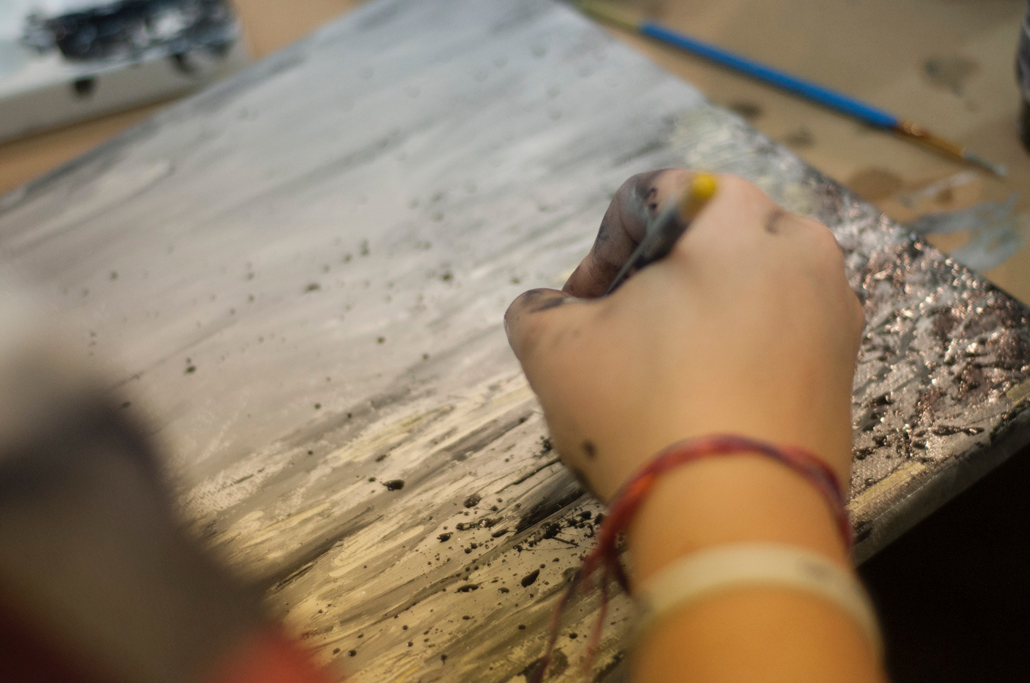
4.
TESTS
Some test cases

Slide 20
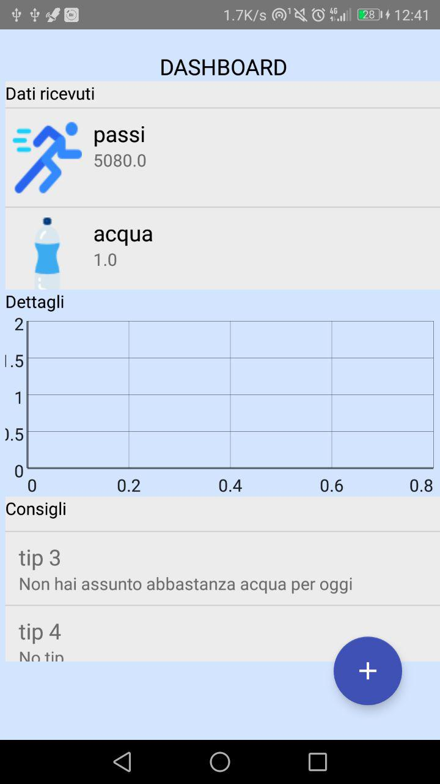
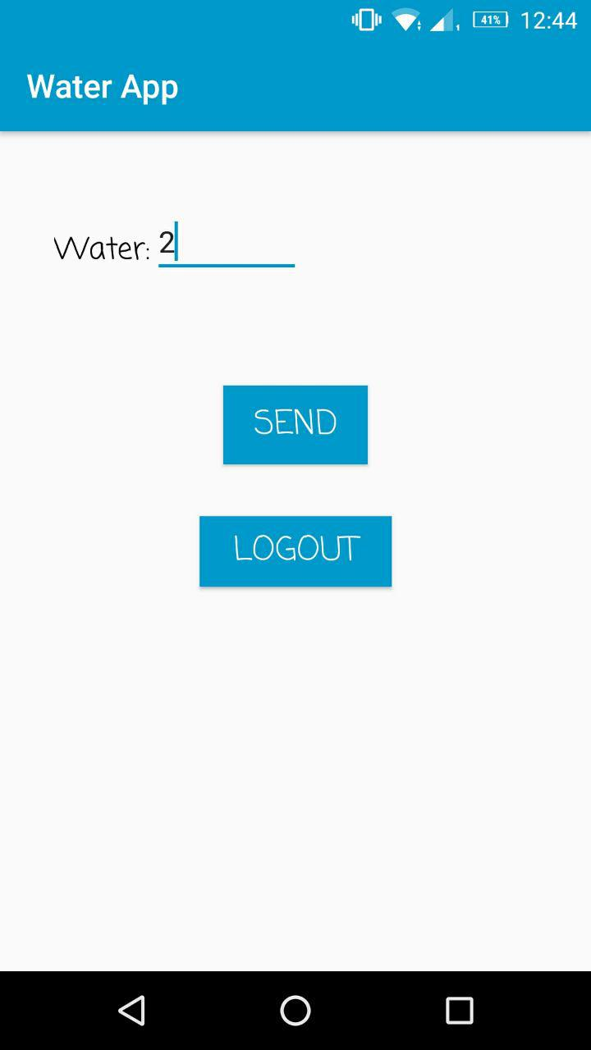
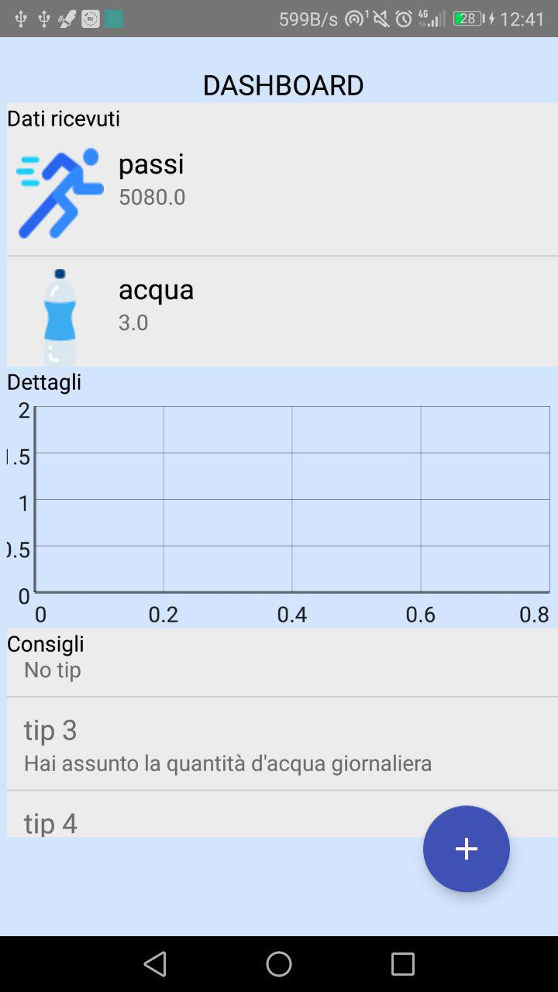
Some test case
User features
Age | 24
Height | 170
Sex | M

Slide 21
CONCLUSIONS AND FUTURE WORKS

Slide 22

Conclusions and future works
Better GUI
User model made by an expert domain
Improve security and scalability
Distribute interfaces
Advertise the project

